Slide 1
Churn Model Presentation
By Baolin, Data Scientist
E Corp
“…one of the largest multi-national conglomerates in the world…”- Mr.Robot Wiki

Slide 2
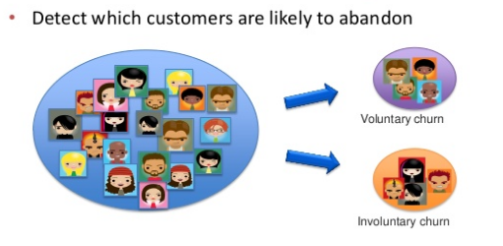
What is Churn Modeling?
http://www.slideshare.net/albahnsen/maximizing-a-churn-campaigns-profitability-with-cost-sensitive-predictive-analytics
Why do we care?
New customers are expensive
Reputation
Revenue
Notes:
Easier to keep a keep customer than find a new one
With technology, one unsatisfied customer can hop on social media and spread the news

Slide 3
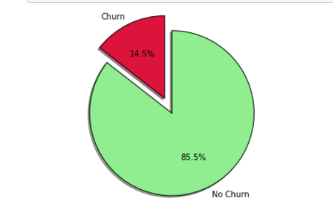
Most people who use our telecom product at E Corp are staying with our product…
BUT:
What can we do to reduce churn to less than 10% ?
Notes:
-just a few percent difference could mean million in revenue

Slide 4
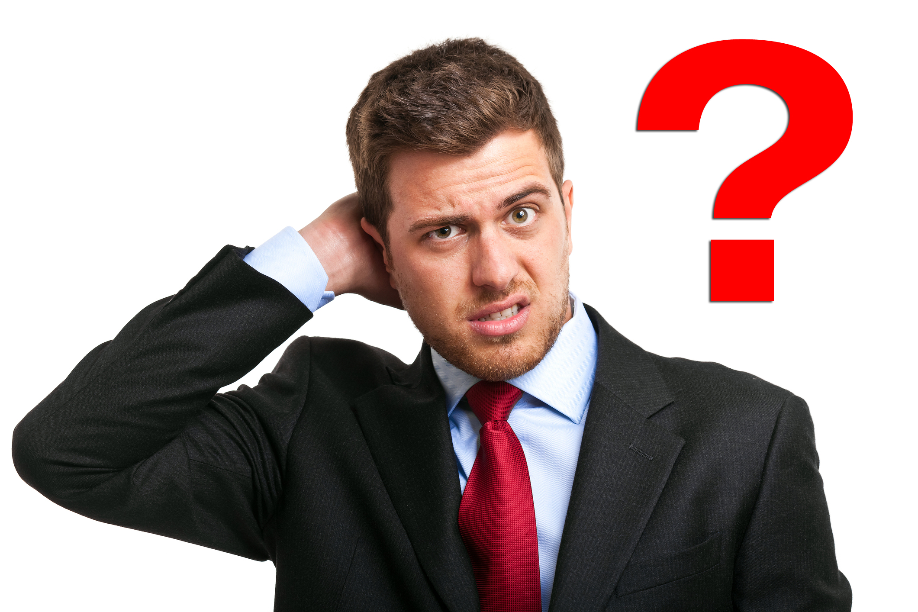
Dataset:
- 3333 customers 20 features (characteristics) were tracked
But how do we make sense of it?
http://nksharmagroup.com/blog/confused-whether-to-buy-a-home-or-not-here-is-the-solution/

Slide 5
Creating the Model:
Find a way to define characteristics of people who churn
Accurately predict time and time again
Actionable insights on those particular characteristics to churn
Data
Insight
Action

Slide 6
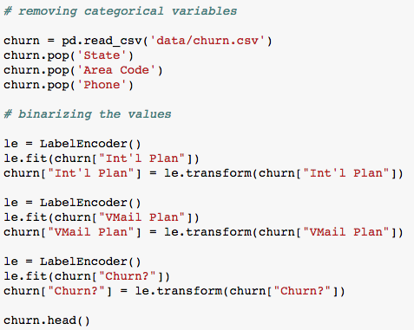
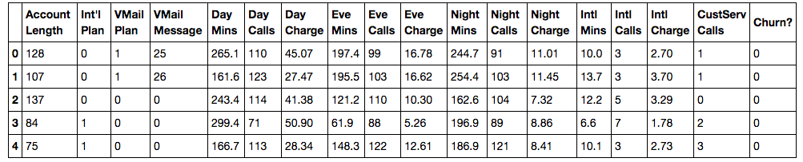
Dropping Unnecessary Features and Binarizing data:
Notes:
State, area code, phone
20 features to 17
True/False, Yes/No to 1s and 0s intl plan vmail plan and churn

Slide 7
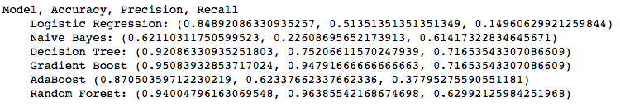
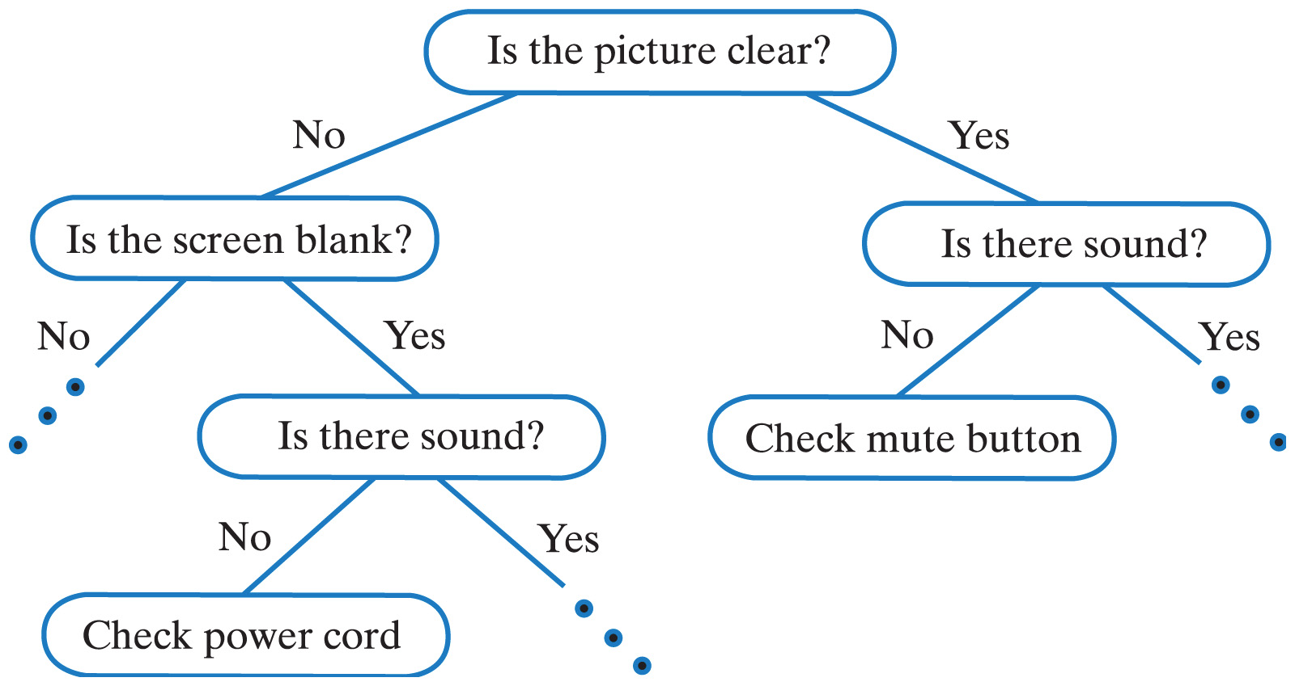
Model Testing:
Decision Tree Models outperformed the rest
http://www.sfs.uni-tuebingen.de/~vhenrich/ss12/java/homework/hw7/decisionTrees.html
Notes:
-using gini entropy to sort classification
gradient boosting combines weak learners into a single strong learner, in an iterative fashion
iteratively, it trains decision trees in order to minimize loss
Using the ensemble method, it predicts the labels against the true labels
Each iteration, the decision tree tries to correct for its previous mistakes, which is why I feel it does so much better than the rest.

Slide 8
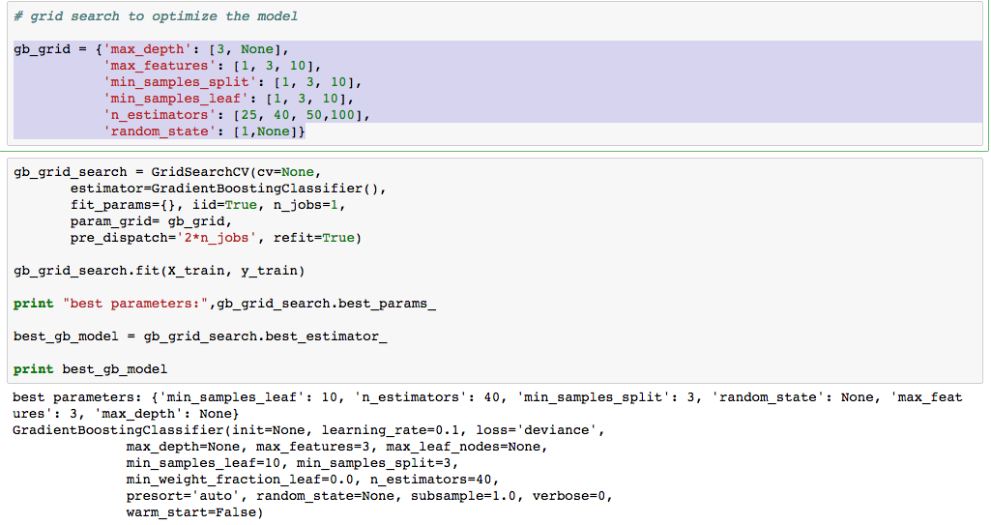
Exhaustive Grid Search:
-looking for the best hyper parameters for the model
Notes:
-optimization the model to the best that it can be, even though it is already predicting at 95%, the predictions were more consistent at the range during the train test split

Slide 9
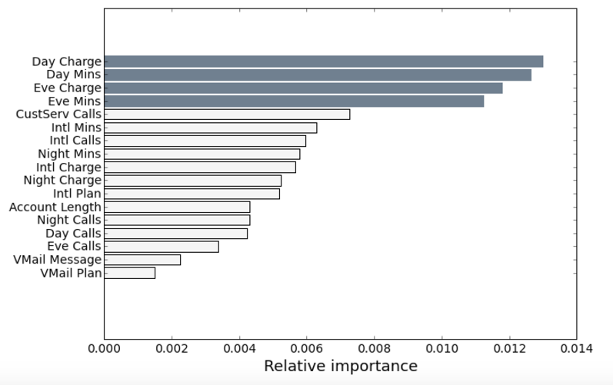
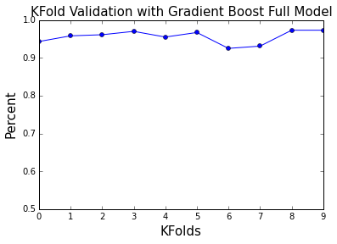
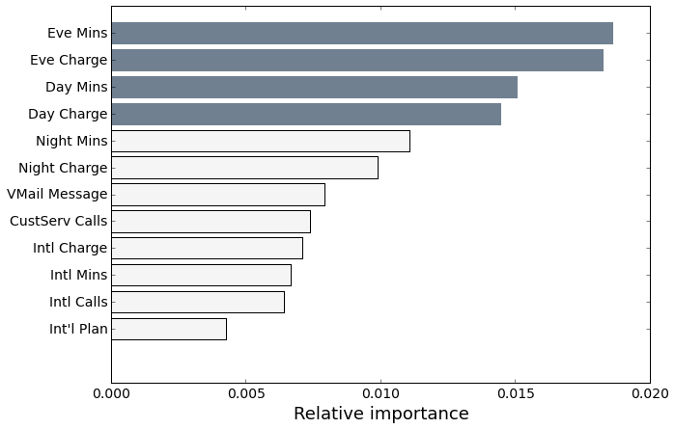
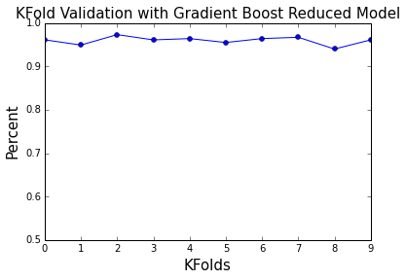
Original Model:
Gradiënt Boost Full Model:
Accuracy: 0.95083932853717024
Precision: 0.91752577319587625
Recall:0.72950819672131151
F1 Score: 0.827906976744
ROC AUC: 0.93
dropped: {'Account Length', 'Day Calls', 'Eve Calls', 'Night Calls', 'VMail Plan'}
Reduced Model:
Gradiënt Boost reduced Model:
Accuracy: 0.956834532374
Precision:0.8942307691
Recall:0.7881355922
F! Score: 0.8378378
ROC AUC : 0.92
Notes:
Removed area code, phone number, and state, no predictive value
Highlight in grey were most important
12 features
17 features
Voicemail was not a stronger predictor, but the use
How many times people called did not matter, it was how long people called, or stayed on the phone
Account length didn’t help in preventing churn.

Slide 10
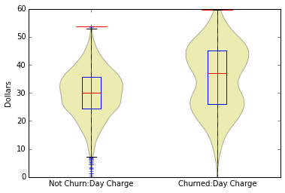
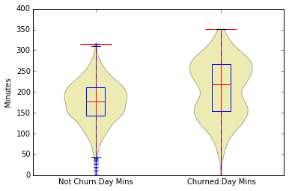
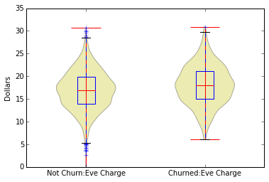
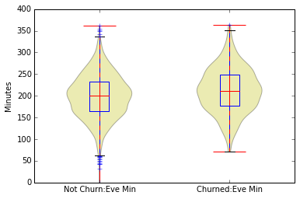

Slide 11
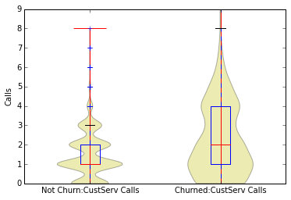

Slide 12
Summary and Recommendation for E Corp:
churn is already low, but to reduce churn further:
-flat rate or unlimited plan has proven to work for other companies, you may lose some revenue in the beginning, but you are able to retain customers and generate more in the long run.
-Customer service could be looked into more to see why people who churned called multiple times
-boosted model worked the best for this type of data

